Slide 1

MyPaper Tableau Dashboard
MyPaper Customer Analysis

Slide 2
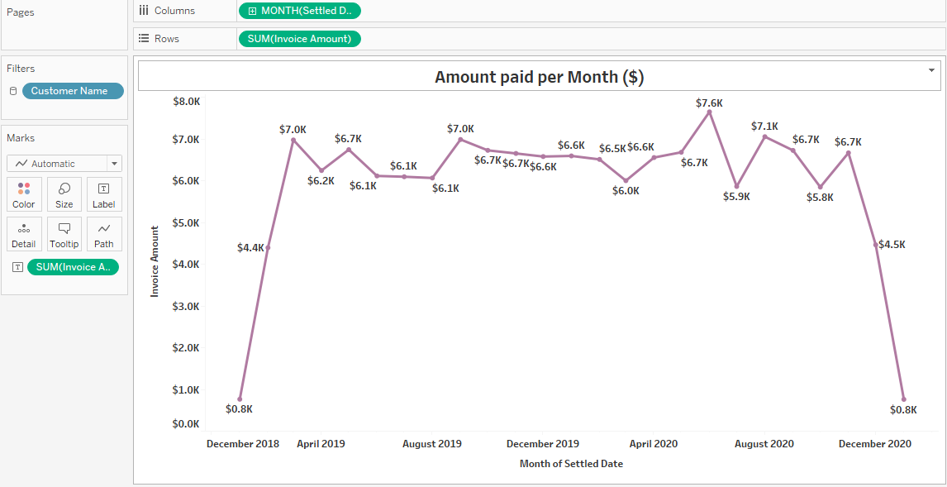
Payments remain relatively stable between $5K and $7K per month. Some months show higher peaks
(~$7.6K) indicating strong payment collections. A drop near the end of the timeline suggests
fewer invoices settled during that month.

Slide 3
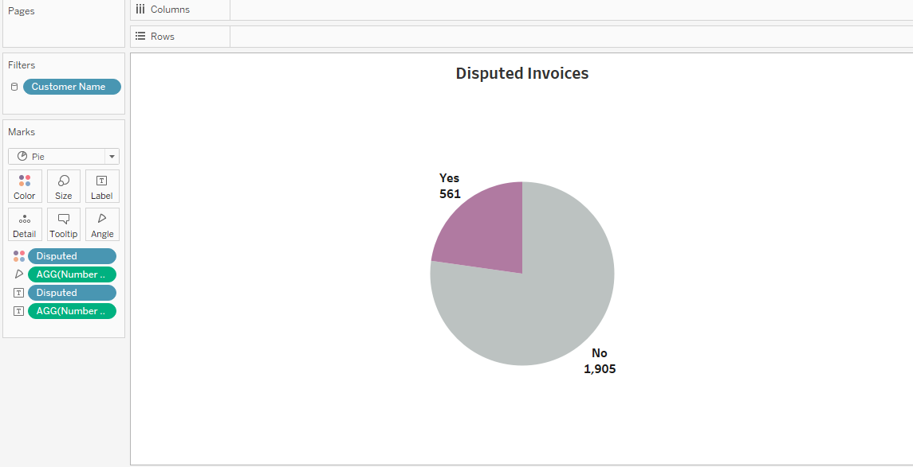
Identifying the proportion of invoices with disputes and evaluate customer satisfaction and billing accuracy we
found out that most transactions are processed smoothly, billing errors or disagreements are relatively low.

Slide 4
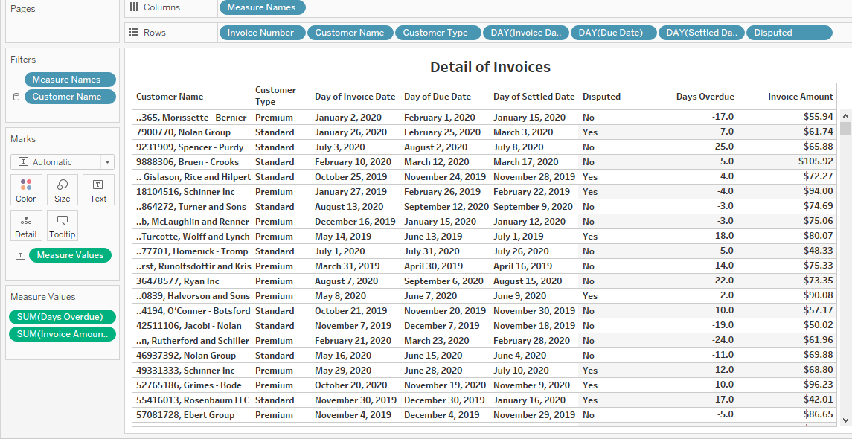
Some invoices are settled before their due dates, resulting in negative overdue days. Certain invoices are marked
as disputed, indicating issues requiring resolution. Both Standard and Premium customers are present in the dataset.

Slide 5
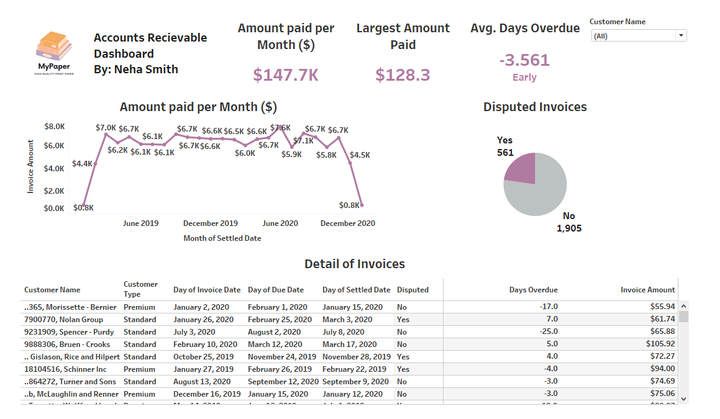
Filters used in Dashboard: Analyze payment behavior for specific customers. Identify customers with frequent disputes
or late payments. Perform customer-level financial analysis.

Slide 6
Outcomes of the Analysis :
From this dashboard analysis, several conclusions can be drawn:
1. Strong Payment Performance
The average days overdue is negative, indicating customers generally pay earlier than the due date, which improves cash flow.
2. Stable Monthly Revenue Collection
The monthly payment trend remains consistent, suggesting predictable revenue inflow.
3. Low Dispute Rate
Only a small percentage of invoices are disputed, meaning most transactions are processed successfully.
4. Effective Receivable Management
The company appears to have effective billing processes and customer payment management.
5. Opportunities for Improvement
Although disputes are relatively low, reducing them further could improve customer satisfaction and operational efficiency.

